Slide 1
Sales & Profitability
Performance Review
(Tableau Analysis)
Andrea Antonuzzo October 26, 2026

Slide 2
Agenda
01. Introduction & Data Overview
02. Sales Performance Over Time
03. Profitability Analysis by Region & City
04. Key Business KPIs
05. Key Insights & Next Steps

Slide 3
Introduction
This analysis explores sales performance and profitability using the Sample Superstore dataset, visualized in Tableau. The objective is to identify key trends over time, evaluate regional and city-level profit dynamics, and summarize core business KPIs. These insights support a clearer understanding of performance drivers and highlight areas for potential improvement.

Slide 4
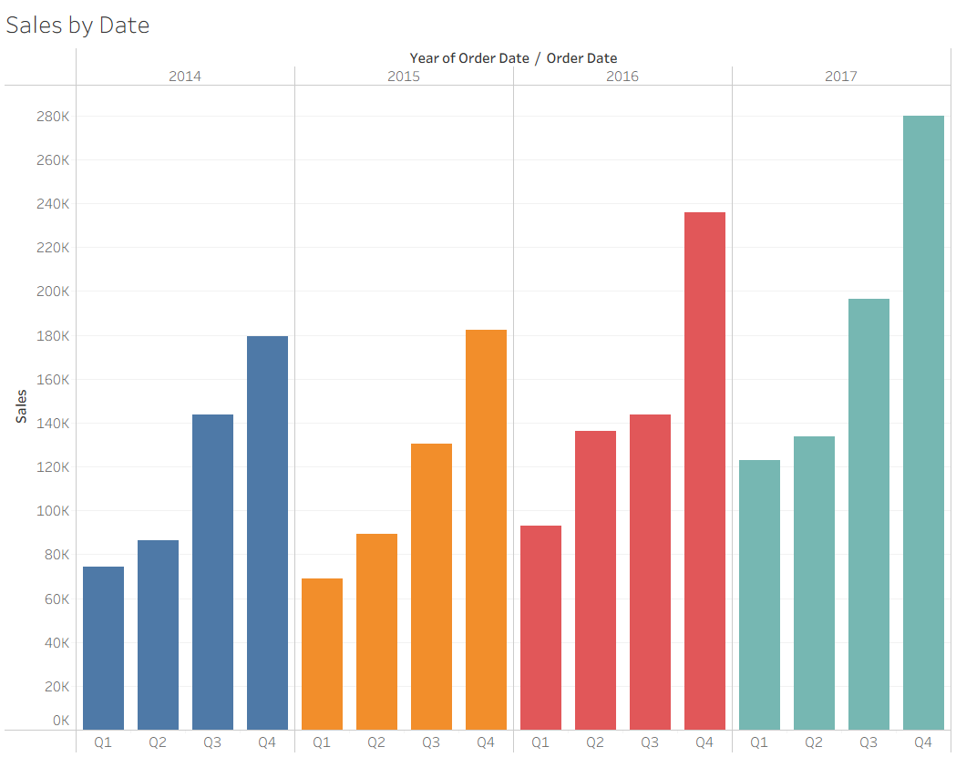
Sales Performance Over Time
Sales show a consistent upward trend from 2014 to 2017, indicating strong business growth
Q4 is the strongest quarter every year, confirming pronounced seasonality effects
2017 records the highest overall sales, highlighting accelerating revenue momentum
Year-over-year growth accelerates after 2016, suggesting improved market traction
To find the real time graph on Tableau click on this link

Slide 5
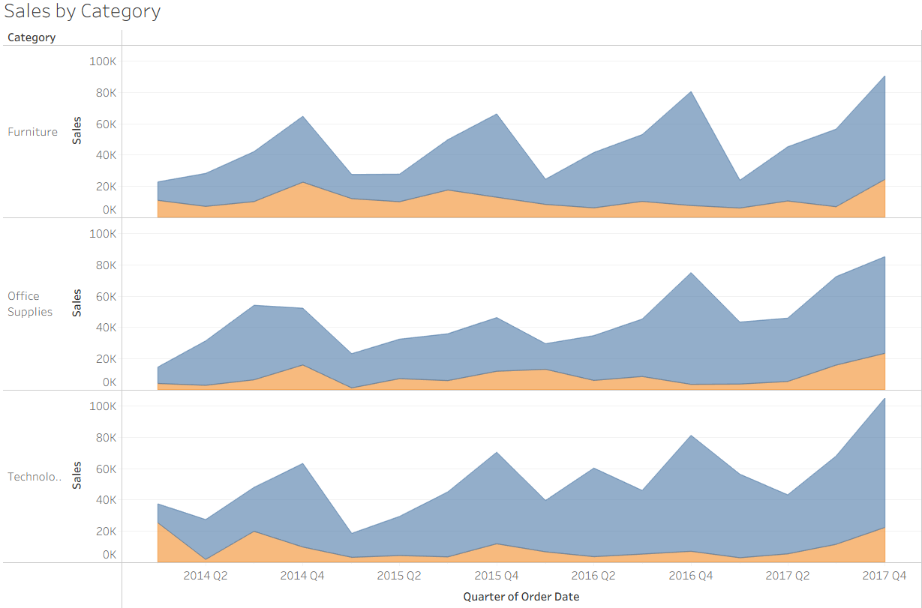
Sales Per Category
Blue area = Sales from profitable Sales
Orange area = Sales from unprofitable Sales
To find the real time graph on Tableau click on this link

Slide 6
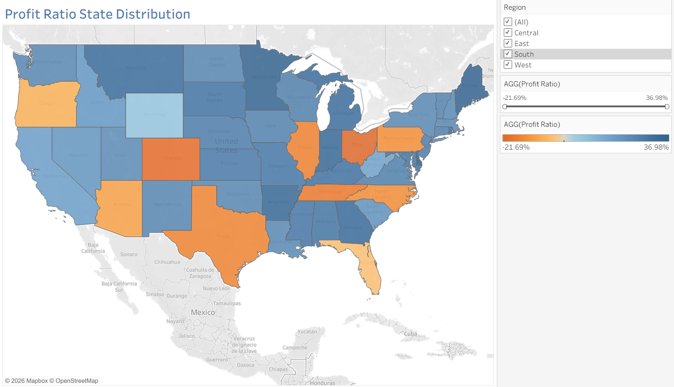
Effective delivery techniques
Coastal and northern states generally outperform, while several central and southern regions show negative margins, revealing clear geographic profitability gaps and highlighting the need for targeted regional pricing and cost optimization strategies.
To find the real time graph on Tableau click on this blue Tab

Slide 7
Sales Per Category
All KPIs and metrics shown were computed directly in Tableau using calculated fields and aggregations on the Sample Superstore dataset
Sales | $2,297,200.86
Profit | $286,397.02
Profit Ratio | 12.47%
Profit per Order | $57.18
Sales per Costumer | $2,896.85
Discount | $1,561.09
Quantity | 37,873
To find the real time graph on Tableau click on this blue link

Slide 8
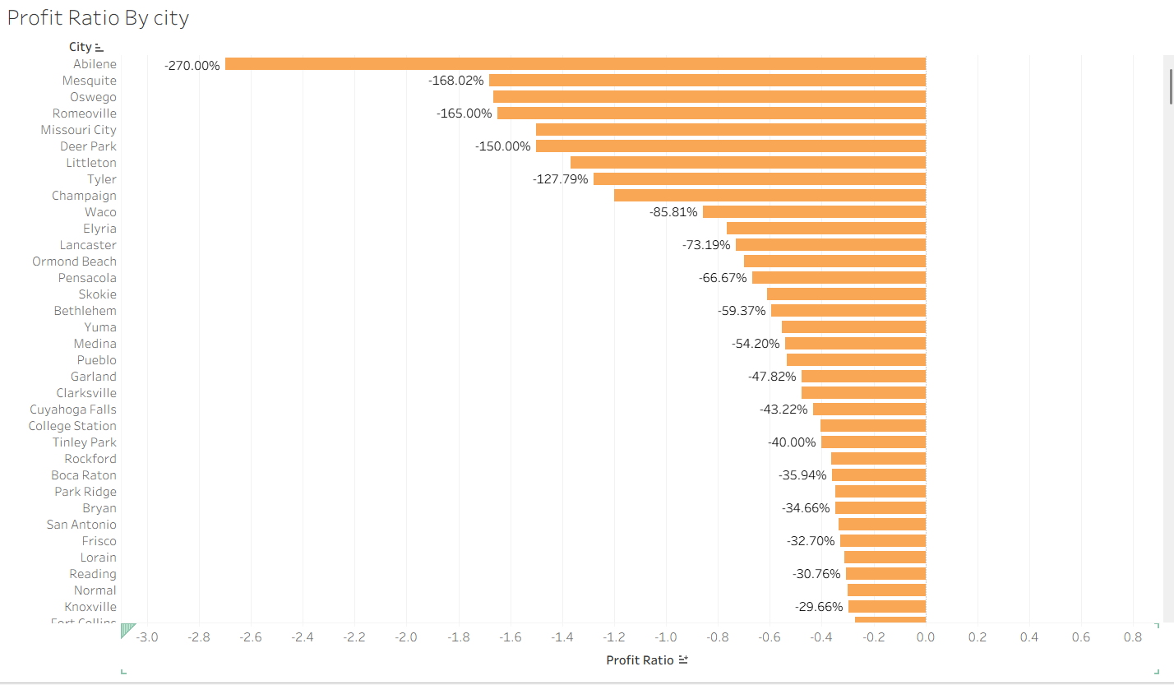
Lowest-performing cities
Several cities exhibit extremely negative profit ratios, indicating severe localized losses
Abilene shows the lowest profitability, representing the most critical performance outlier
Targeted pricing, cost control, and product strategy are required to improve profitability
To find the real time graph on Tableau click on this blue link

Slide 9
Main Takeaways
Sales show strong upward momentum from 2014 to 2017, with consistent Q4 seasonality driving peak performance
Technology is the primary growth driver, while Furniture underperforms and requires margin optimization
Profitability varies significantly by geography, with coastal and northern states outperforming central and southern regions
City-level analysis reveals concentrated losses in a small number of locations, highlighting targeted improvement opportunities

Slide 10
Thank you
Andrea Antonuzzo
+(1) 201-241-6048
aantonuz@stevens.edu

